Slide 1


Lidia Puspa N
TokoBli E-commerce
Campaign Effectiveness Analysis
Spreadsheet: https://docs.google.com/spreadsheets/d/1eNbhNIBm-rKsRo5YPQBeqP2iWywkBj8JGB9tNWzQ5FE/edit?usp=sharing

Slide 2

Business Overview
TokoBli, Indonesia’s largest e-commerce platform. The platform offers a variety of products, including men's and women's fashion, electronics, home living, and more. During twin date events such as October 10, November 11, and December 12, TokoBli holds major sales campaigns featuring flash salesa nd free shipping. During these periods, transaction volumes can increase up to 10 times compared to regular days.
Over the past three campaign periods, the team has tested three different campaign strategies:
October 10, 2023 (10/10): Implemented Campaign Scenario A
November 11, 2023 (11/11): Implemented Campaign Scenario B
December 12, 2023 (12/12): Implemented Campaign Scenario C
To optimize the upcoming campaign, the business team has tasked the data analytics team with evaluating and deriving insights from the past three campaigns and their respective scenarios. The key metrics to analyze include:
Campaign budget for discounts
Number of transactions
Number of customers
Number of products sold
Revenue earned during the campaign period
The goal is to assess these metrics across the three campaign scenarios to determine the most effective strategy, helping to maximize revenue and transactions while keeping the campaign budget efficient.

Slide 3

Problem Statement
To identify which campaign scenario generates the highest revenue while minimizing the campaign budget.
To identify the product category that generates the highest transactions and revenue while utilizing the lowest discount budget for each campaign.
DARCI
DARCI | PIC | Reason
Decider | Head of Business Operation | Person who has more authority to make corporate-scale decisions
Accountable | Head of Data | the position above the data analyst can be an umbrella, has some decision-making power and is more related to operational
Responsible | Data Analyst | position that does the job
Consulted | Marketing team, Sales team, Business team | Stakeholders who can give advice on the main problem related to marketing strategy, sales optimization, and business decision-making.
Informed | Finance, Marketing team | The finance team must be informed because any changes will impact the budget, which they need to account for. Similarly, the marketing team must be aware, as they are responsible for executing the project.

Slide 4

METRICS
Problem Statement | Metrics | Purpose | Formula
To indentify which campaign scenario generates the highest revenue while minimizing the campaign budget. | Total Revenue per campaign | To determine which of the three previous campaign strategies (10/10, 11/11, or 12/12) generates the highest revenue | Total Revenue per campaign = ∑Total Revenue (grouped by Campaign)
 | Average Revenue per Campaign | To evaluate the profitability and effectiveness of each campaign | Average Revenue per Campaign = Total Transactions per Campaign / Total Revenue per Campaign​
 | Total Discount Given per Campaign | To analyze the cost-effectiveness of each campaign | Total Discount per Campaign = ∑Discount (grouped by Campaign)
 | Average Discount Given per Campaign | To analyze the effectiveness of discounts of each campaign | Average Discount per Campaign = ∑Total Transactions per Campaign / ∑Total Discount per Campaign​
 | ROI per Campaign | To evaluate the profitability and effectiveness of each campaign by analyzing its ROI | ROI =((Total Revenue -Total Campaign Budget) / Total Campaign Budget ​×100%
 | Discount-to-Revenue Ratio per Campaign | To Determines how much discount spending contributes to revenue generation, helping to assess cost-effectiveness. | Discount-to-Revenue Ratio= (Total Revenue/Total Discount Given​) ×100%
To identify the product category that generates the highest transactions and revenue while utilizing the lowest discount budget for each campaign. | Total Transactions per Product Category (per Campaign) | To Determines which product category has the highest number of transactions in each campaign. | Transactions per Category=∑(Transaction Count by Category per Campaign)
 | Total Revenue per Product Category (per Campaign) | To Identifies which product category contributes the most revenue within each campaign. | Total Revenue per Category=∑(Price×QTY) by Category per Campaign
 | Discount-to-Revenue Ratio per Product Category (per Campaign) | To Evaluates how efficiently a product category converts discount spending into revenue, helping optimize future discount allocations. | Discount-to-Revenue Ratio=(Total Revenue per Category/Total Discount Given per Category​)×100%

Slide 5
Clean Up the Data (1/7)
Checking the rows and columns for missing values using COUNTBLANK revealed three rows, each containing one empty cell:
User ID-147 → Price
User ID-152 → Quantity (QTY)
User ID-177 → Discount
Since the missing values in these variables can still be reasonably estimated, we decided to impute the missing data for these three cells.
Before
After
Spreadsheet: https://docs.google.com/spreadsheets/d/1eNbhNIBm-rKsRo5YPQBeqP2iWywkBj8JGB9tNWzQ5FE/edit?usp=sharing

Slide 6
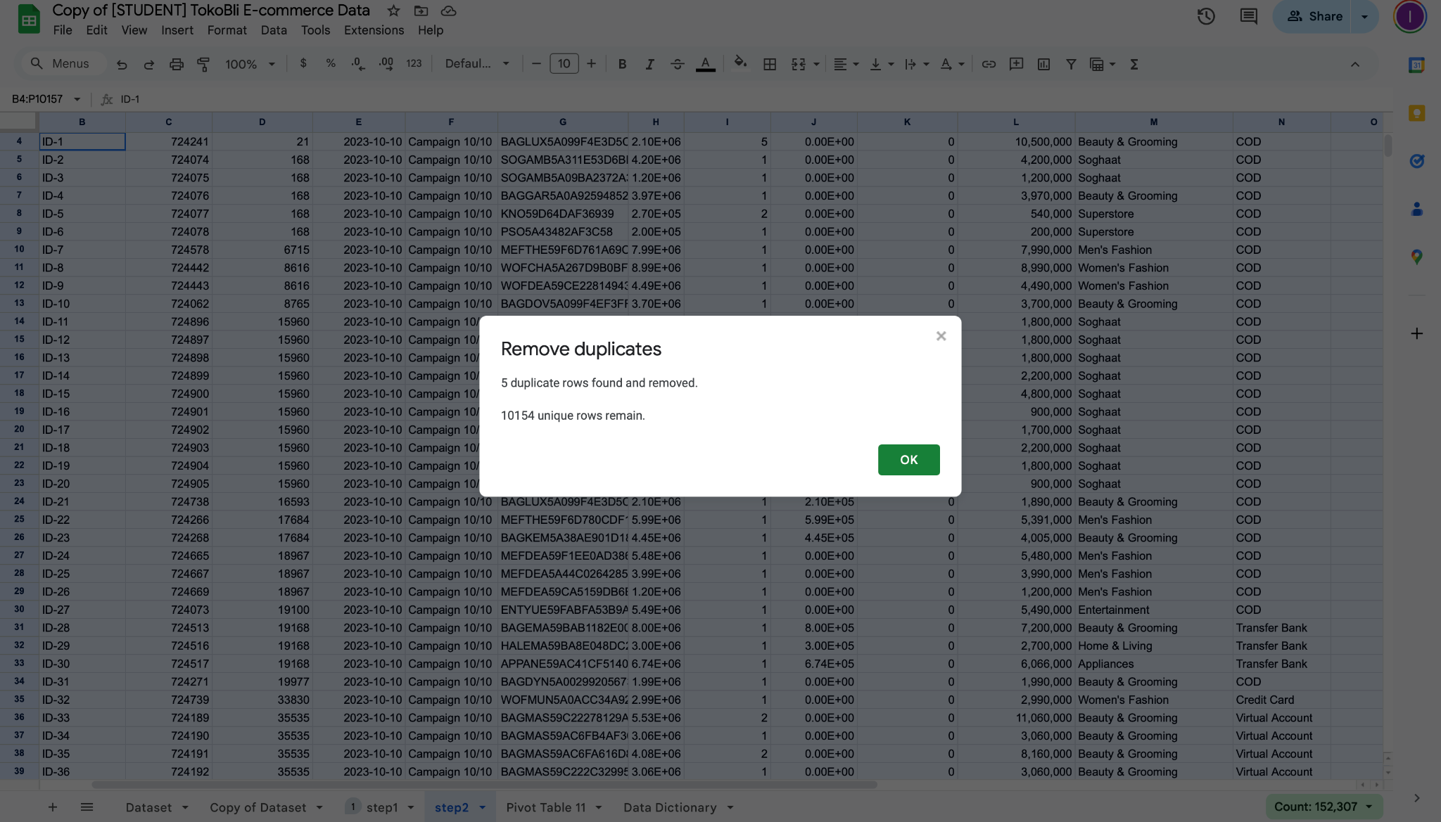
Clean Up the Data (2/7)
2. Next, we removed duplicate data by clicking on the Ribbon Menu → Data → Remove Duplicates. This process identified five duplicate rows, reducing the total number of records from 10,159 to 10,154.
Spreadsheet: https://docs.google.com/spreadsheets/d/1eNbhNIBm-rKsRo5YPQBeqP2iWywkBj8JGB9tNWzQ5FE/edit?usp=sharing

Slide 7
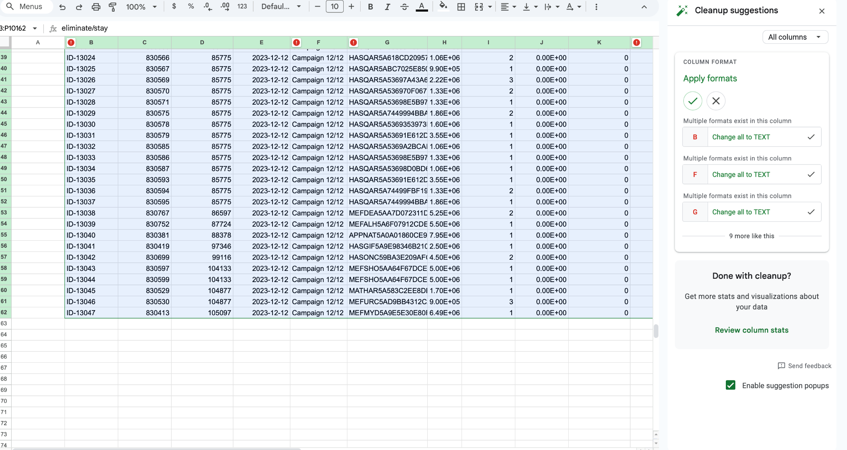
Clean Up the Data (3/7)
2. Next, we adjusted the data types for columns that were not correctly formatted. Before manually inspecting each column, we used the Ribbon Menu → Data → Cleanup Suggestions tool, which identified nine columns requiring data type adjustments or else. After further manual inspection, we applied the necessary changes to the following seven columns:
Spreadsheet: https://docs.google.com/spreadsheets/d/1eNbhNIBm-rKsRo5YPQBeqP2iWywkBj8JGB9tNWzQ5FE/edit?usp=sharing

Slide 8
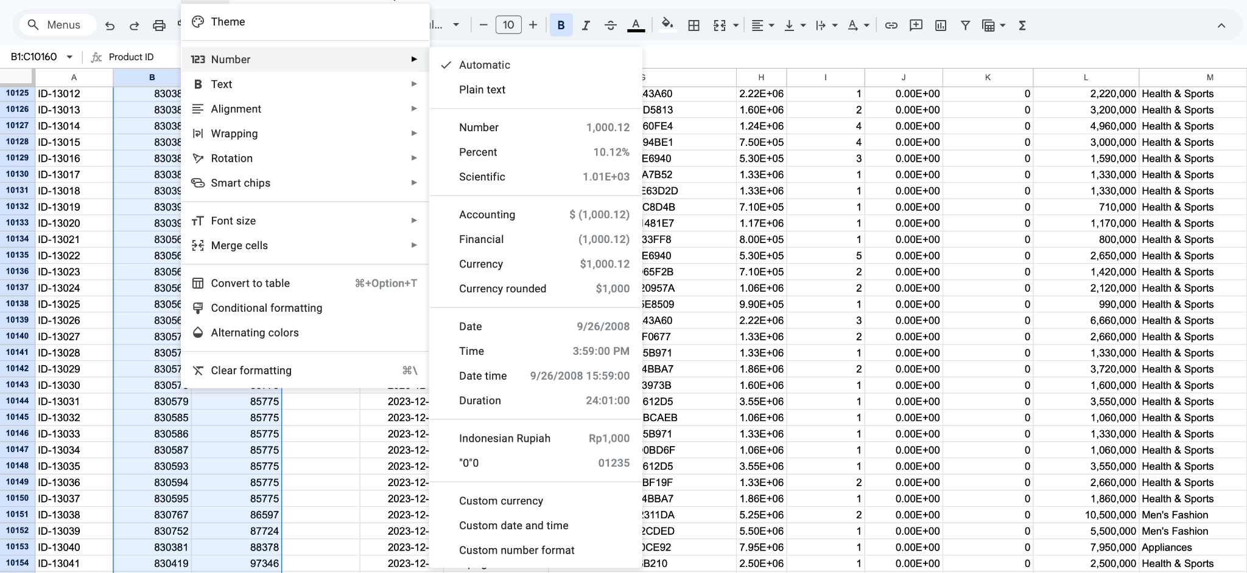
Clean Up the Data (4/7)
2. Next, we adjusted the data types for columns that were not correctly formatted. Before manually inspecting each column, we used the Ribbon Menu → Data → Cleanup Suggestions tool, which identified nine columns requiring data type adjustments or else. After further manual inspection, we applied the necessary changes to the following seven columns:
Column: Product ID,Customer ID (automatic -> plain text ( karena bilangan hanya sebagai penanda dan tidak mengandung nilai))
Spreadsheet: https://docs.google.com/spreadsheets/d/1eNbhNIBm-rKsRo5YPQBeqP2iWywkBj8JGB9tNWzQ5FE/edit?usp=sharing

Slide 9
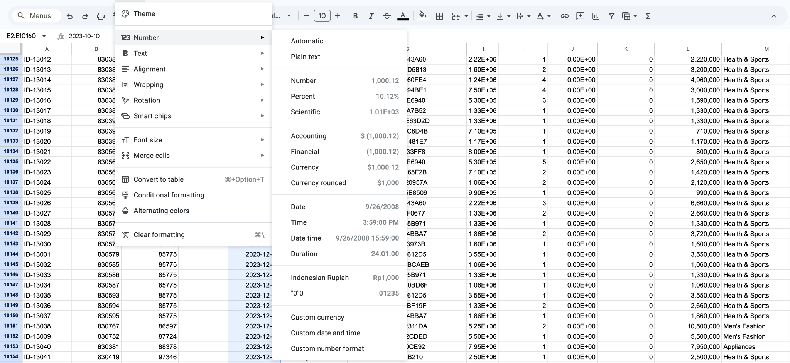
Clean Up the Data (5/7)
2. Next, we adjusted the data types for columns that were not correctly formatted. Before manually inspecting each column, we used the Ribbon Menu → Data → Cleanup Suggestions tool, which identified nine columns requiring data type adjustments or else. After further manual inspection, we applied the necessary changes to the following seven columns:
Column: Created At (undetected -> date)
Spreadsheet: https://docs.google.com/spreadsheets/d/1eNbhNIBm-rKsRo5YPQBeqP2iWywkBj8JGB9tNWzQ5FE/edit?usp=sharing

Slide 10
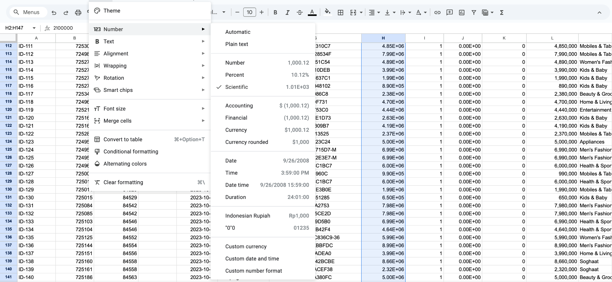
Clean Up the Data (6/7)
2. Next, we adjusted the data types for columns that were not correctly formatted. Before manually inspecting each column, we used the Ribbon Menu → Data → Cleanup Suggestions tool, which identified nine columns requiring data type adjustments or else. After further manual inspection, we applied the necessary changes to the following seven columns:
Column: Price, Discount (Scientific -> Currency in rupiah)
Spreadsheet: https://docs.google.com/spreadsheets/d/1eNbhNIBm-rKsRo5YPQBeqP2iWywkBj8JGB9tNWzQ5FE/edit?usp=sharing

Slide 11
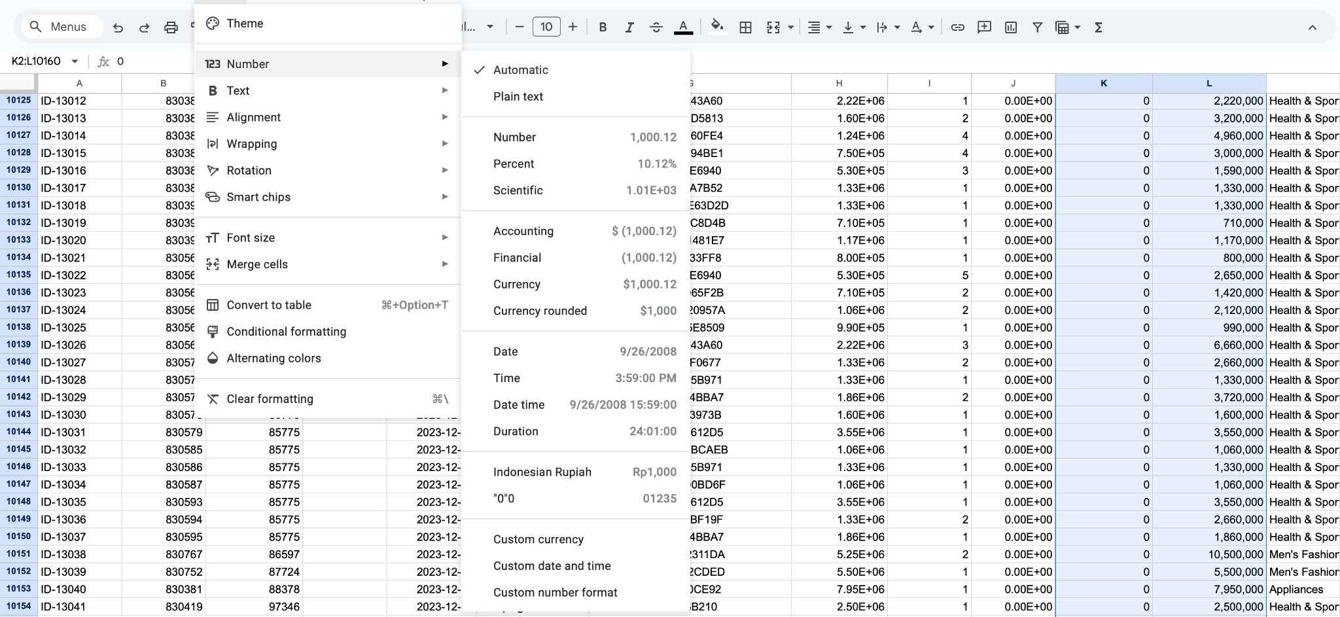
Clean Up the Data (7/7)
2. Next, we adjusted the data types for columns that were not correctly formatted. Before manually inspecting each column, we used the Ribbon Menu → Data → Cleanup Suggestions tool, which identified nine columns requiring data type adjustments or else. After further manual inspection, we applied the necessary changes to the following seven columns:
Column: Shipping Cost,Total Revenue ( Number -> Currency in rupiah)
Spreadsheet: https://docs.google.com/spreadsheets/d/1eNbhNIBm-rKsRo5YPQBeqP2iWywkBj8JGB9tNWzQ5FE/edit?usp=sharing

Slide 12
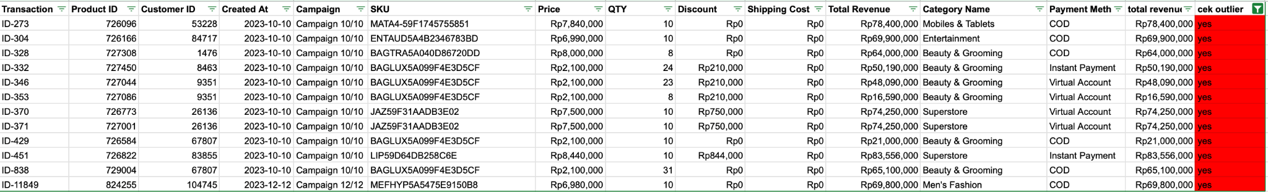
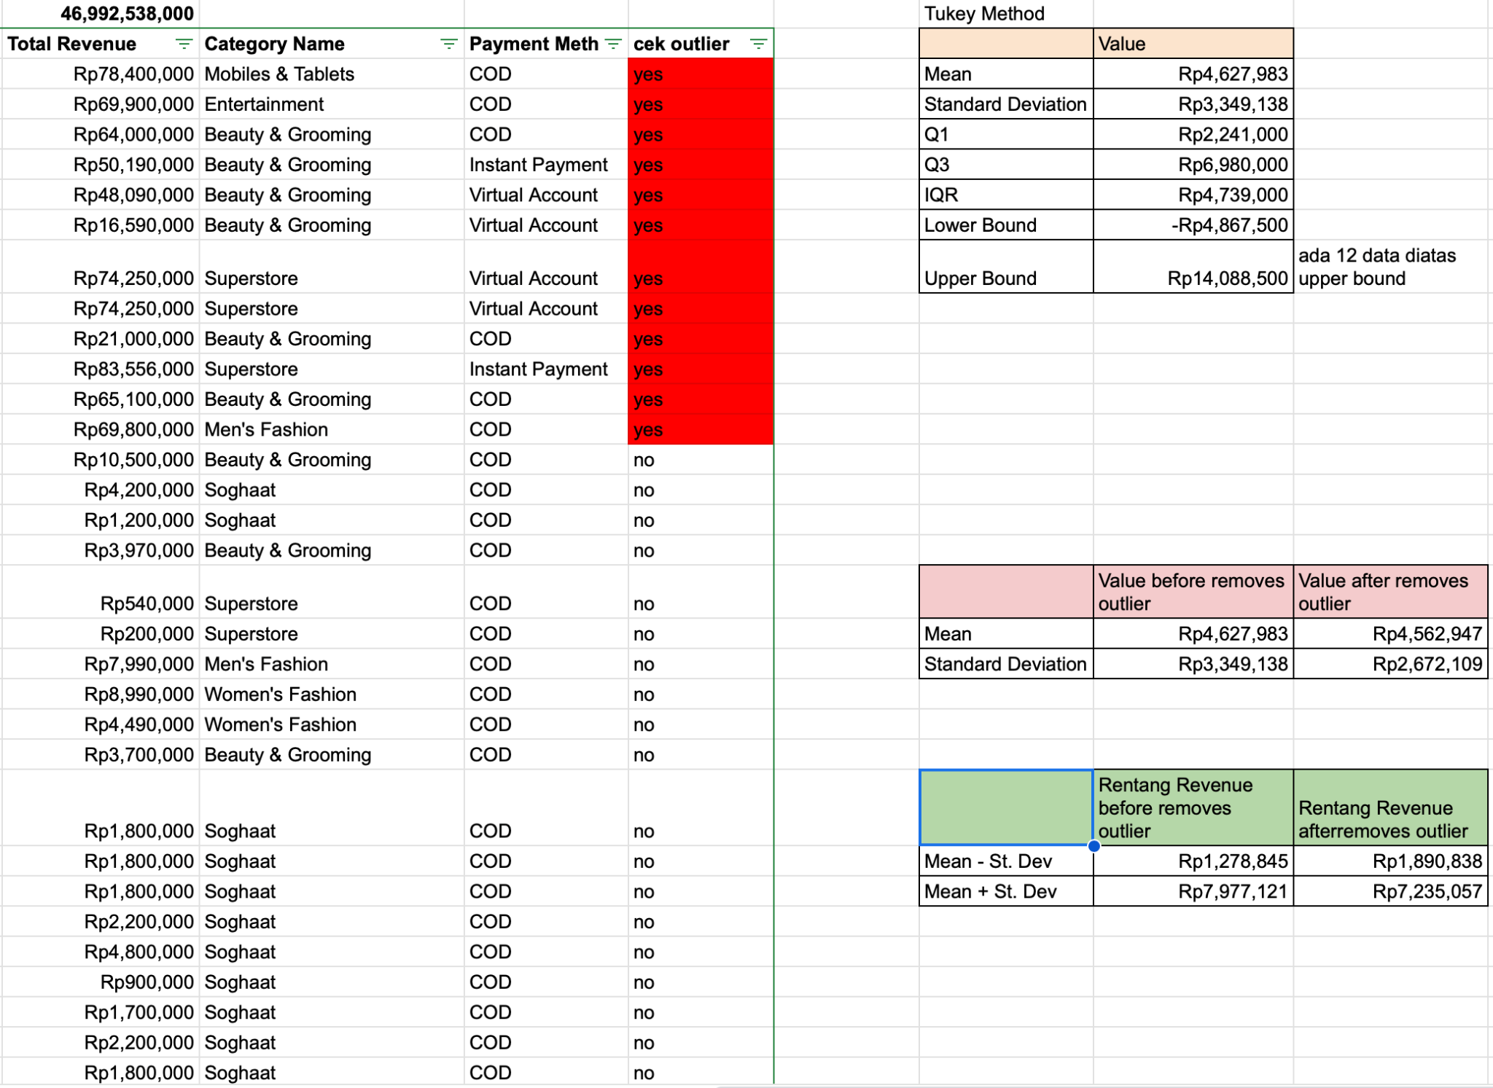
Check Outlier
Using the IQR method, we remove total revenue values below -Rp4,867,500 (lower bound) and above Rp14,088,500 (upper bound) to eliminate outliers.
Looking at the mean and standard deviation:
Revenue range before removing outliers: Rp1,278,845 – Rp7,977,121
Revenue range after removing outliers: Rp1,890,838 – Rp7,235,057
After removing outliers, the number of data points decreased from 10,154 to 10,142, indicating that 12 extreme values were identified and removed. And the standard deviation decreases, indicating that the revenue distribution becomes more centered around the mean, more stable, and less influenced by extreme values. This may also suggest that the revenue distribution is closer to a normal distribution, making statistical analysis more accurate and reliable.
Spreadsheet: https://docs.google.com/spreadsheets/d/1eNbhNIBm-rKsRo5YPQBeqP2iWywkBj8JGB9tNWzQ5FE/edit?usp=sharing

Slide 13
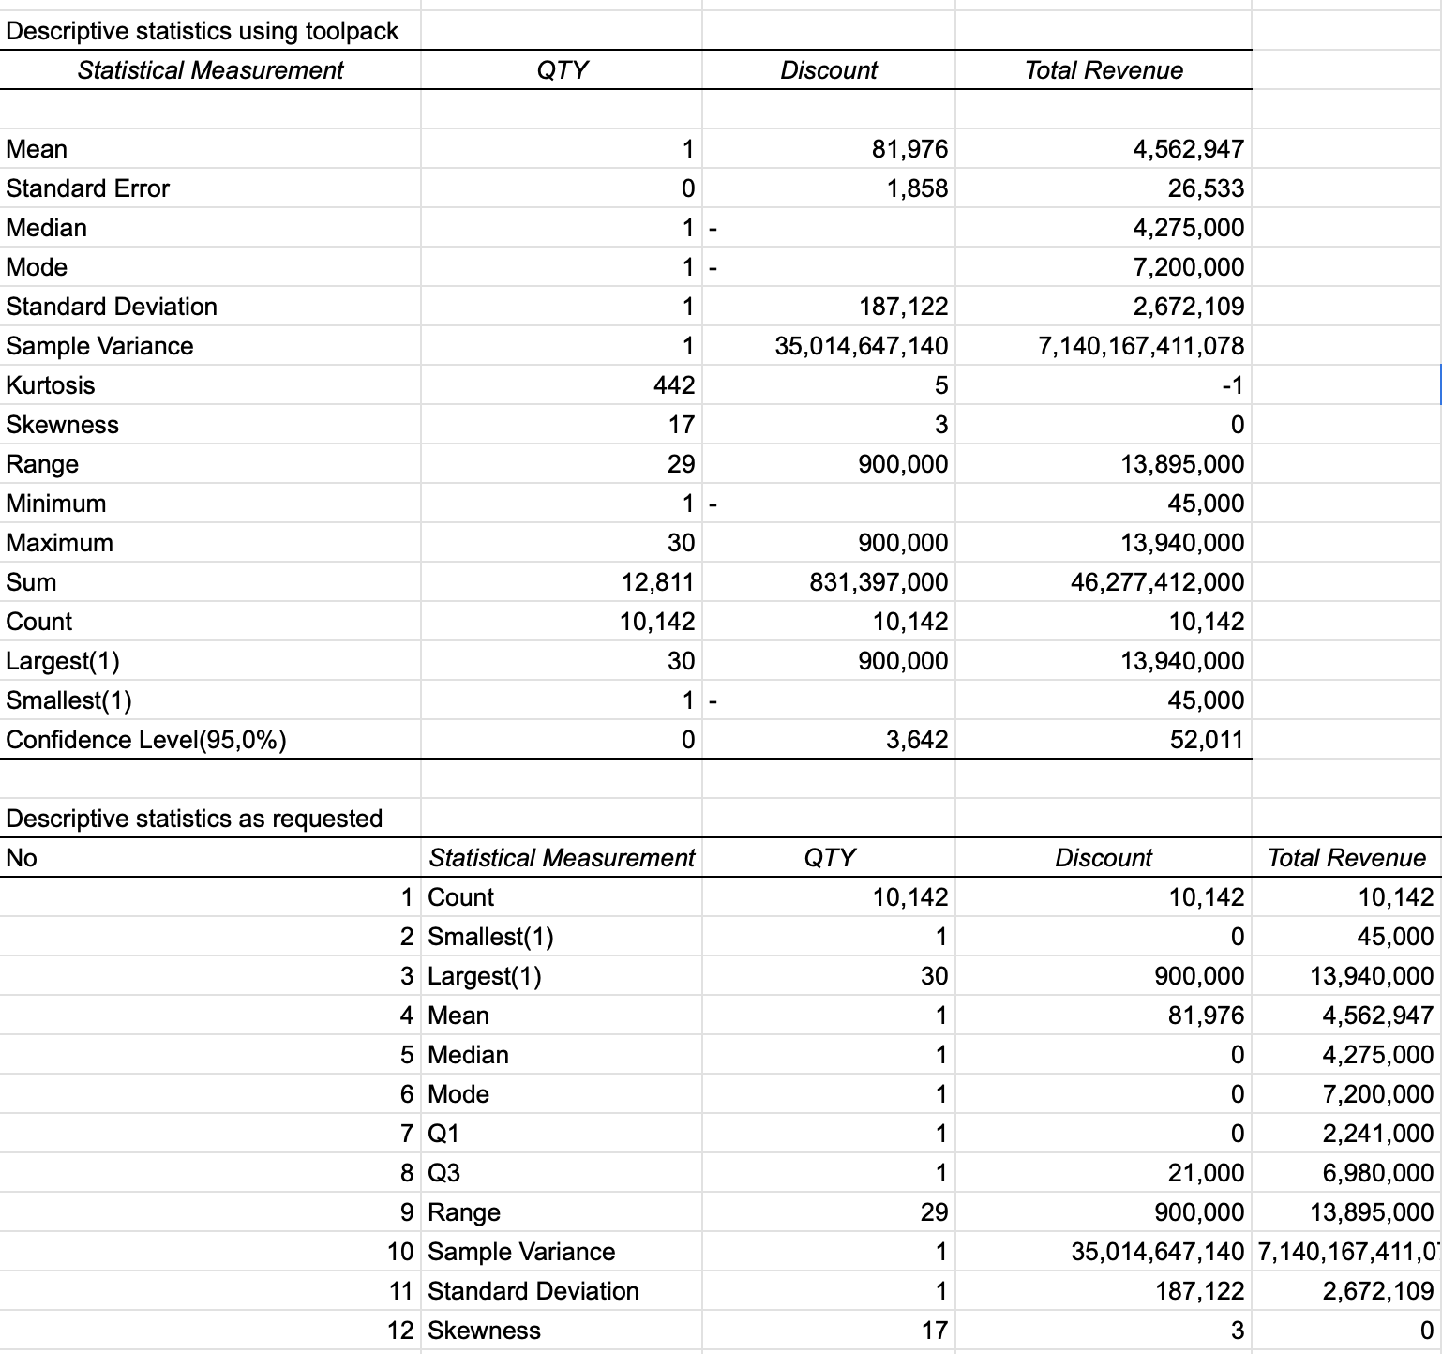
Descriptive Statistics (1/3)
Overview of Descriptive Statistics Results Using ToolPak
Spreadsheet: https://docs.google.com/spreadsheets/d/1eNbhNIBm-rKsRo5YPQBeqP2iWywkBj8JGB9tNWzQ5FE/edit?usp=sharing

Slide 14
Descriptive Statistics (2/3)
No | Statistical Measurement | QTY | Discount | Total Revenue | Interpretation
1 | Count | 10,142 | 10,142 | 10,142 | The total number of data in each variable is 10,142 transactions.
2 | Smallest | 1 | 0 | 45,000 | Each variable has different minimum values: the smallest quantity is 1 unit, many transactions have no discount (0), and the lowest transaction revenue is Rp45,000.
3 | Largest | 30 | 900,000 | 13,940,000 | Each variable has different maximum values: the highest quantity in a transaction is 30 units, the highest discount is Rp900,000, and the highest total revenue is Rp13,940,000.
4 | Mean | 1 | 81,976 | 4,562,947 | The average for each variable: 1 unit per transaction, average discount of Rp81,976, and average transaction revenue of Rp4,562,947.
5 | Median | 1 | 0 | 4,275,000 | The variable quantity has a median value of 1, the discount variable has a median value of 0, and the total revenue variable has a median value of Rp4,275,000. The median is more resistant to outliers than the mean, so if the median is smaller than the mean, it is likely that some extremely high values are pulling the average up.
6 | Mode | 1 | 0 | 7,200,000 | The most frequently ordered quantity is 1 unit, the most common discount is 0 (many transactions have no discount), and the most frequently generated revenue is Rp7,200,000.
Spreadsheet: https://docs.google.com/spreadsheets/d/1eNbhNIBm-rKsRo5YPQBeqP2iWywkBj8JGB9tNWzQ5FE/edit?usp=sharing

Slide 15
Descriptive Statistics (3/3)
No | Statistical Measurement | QTY | Discount | Total Revenue | Interpretation
7 | Q1 | 1 | 0 | 2,241,000 | 25% of transactions have ≤ 1 unit, 0 discount, and ≤ Rp2,241,000 revenue.
8 | Q3 | 1 | 21,000 | 6,980,000 | 75% of transactions have ≤ 1 unit, discounts ≤ Rp21,000, and revenue ≤ Rp6,980,000.
9 | Range | 29 | 900,000 | 13,895,000 | The difference between the highest and lowest quantity is 29 units, the difference between the highest and lowest discount is Rp900,000, and the difference between the highest and lowest revenue is Rp13,895,000.
10 | Sample Variance | 1 | 35,014,647,140 | 7,140,167,411,010 | Quantity variance = 1, meaning the number of items per transaction is almost the same. Discount variance = 35,014,647,140, indicating a significant variation in discounts across transactions. Total revenue variance = 7,140,167,411,010, showing very high variation in transaction revenue.
11 | Standard Deviation | 1 | 187,122 | 2,672,109 | Most transactions have ±1 unit from the average, discounts within ±Rp187,122, and revenues within ±Rp2,672,109. The higher the standard deviation, the greater the data spread from the average.
12 | Skewness | 17 | 3 | 0 | Quantity skewness = 17, indicating a highly right-skewed distribution (many transactions with small quantities, but some with large numbers). Discount skewness = 3, showing a right-skewed distribution where most transactions have no discount, but some have high discounts. Total revenue skewness = 0, indicating an almost normal distribution of revenue.
Spreadsheet: https://docs.google.com/spreadsheets/d/1eNbhNIBm-rKsRo5YPQBeqP2iWywkBj8JGB9tNWzQ5FE/edit?usp=sharing

Slide 16
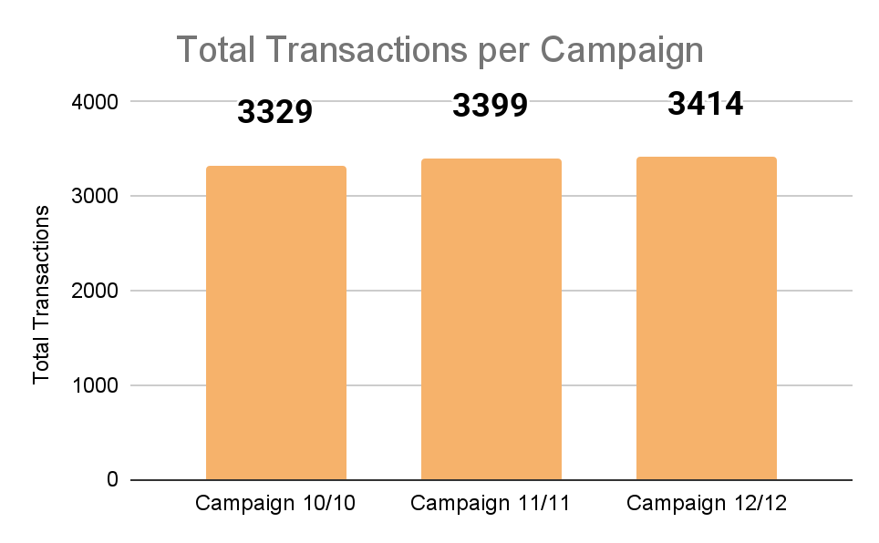
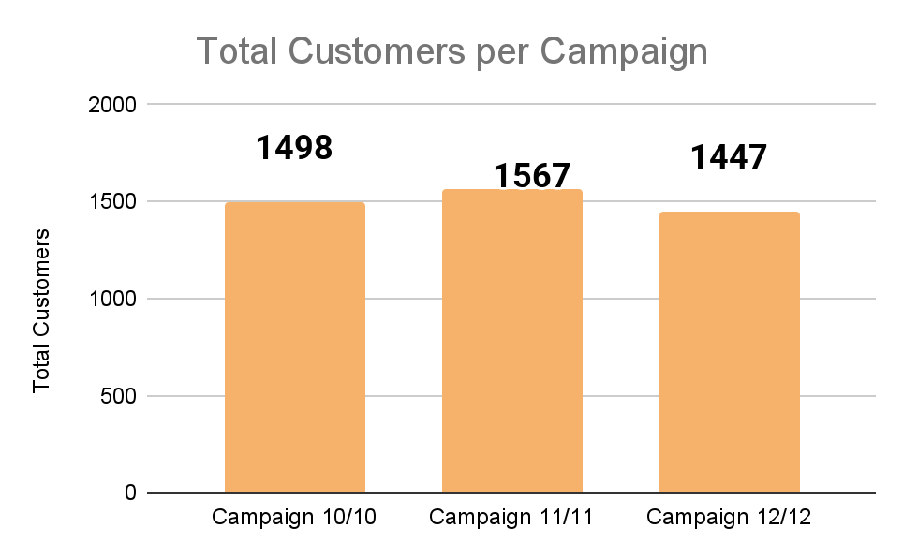
EDA (1/8)
Total transactions & Total Customers per Campaign
· This chart is created using pivots and summarizes transaction data ID by counta per each campaign.
· This chart shows the total number of transactions that occurred during the 3 campaign periods. There is a trend of increasing the number of transactions from one campaign to the next.
· The number of transactions from the 10/10 campaign (3329 transactions) increased by 2.1% when compared to the 11/11 campaign (3399 transactions) then increased again by 0.4% when compared to the 12/12 campaign (3414 transactions)
· Overall, there was a 2.6% increase in transactions from the 10/10 campaign to the 12/12 campaign.
· This upward trend can indicate that more customers are participating in promos or that there is a more effective marketing strategy over time.
· This chart is created using pivots and summarizes customer data ID by countunique per each campaign.
· This chart shows the total number of customers who made transactions during the 3 campaign periods. There is a fluctuation in the number of customers across the campaigns.
· The number of customers in the 10/10 campaign (1498 customers) increased by 4.6% compared to the 11/11 campaign (1567 customers), then decreased by 7.6% in the 12/12 campaign (1447 customers).
· Overall, there was a 3.4% decrease in the number of customers from the 10/10 campaign to the 12/12 campaign.
· When linked to the increasing transaction trend, this indicates that one customer completed multiple checkouts per campaign. This suggests that customers were more likely to split their purchases into multiple transactions rather than making a single checkout.
Spreadsheet: https://docs.google.com/spreadsheets/d/1eNbhNIBm-rKsRo5YPQBeqP2iWywkBj8JGB9tNWzQ5FE/edit?usp=sharing

Slide 17
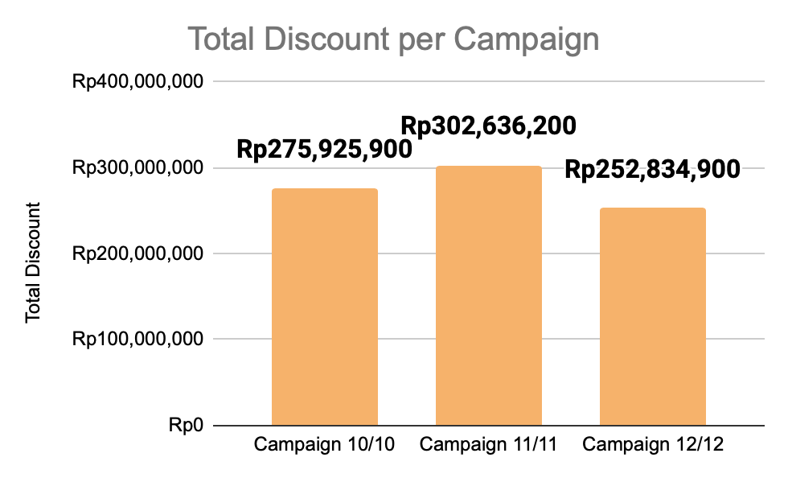
EDA (2/8)
Total Discount per Campaign
• This chart is created using pivots and summarizes discount data by sum discount per each campaign.
• This chart shows the total discount given during the three campaign periods. There is a fluctuation in the amount of discounts provided across the campaigns.
• The total discount in the 10/10 campaign (Rp275,925,900) increased by 9.7% in the 11/11 campaign (Rp302,636,200) , then decreased by 16.5% in the 12/12 campaign (Rp252,834,900).
• The total discount given reached its highest amount in the 11/11 campaign and its lowest in the 12/12 campaign.
• Despite the total discount being the lowest in the 12/12 campaign, the total number of transactions was the highest. This suggests that the amount of discount provided does not directly impact the total number of transactions.
• When linked to the decreasing number of customers, this indicates that customers completed multiple checkouts per campaign. Instead of relying on larger discounts, customers likely adopted a strategy of splitting their purchases into multiple transactions, leading to a continuous increase in the number of transactions.
Spreadsheet: https://docs.google.com/spreadsheets/d/1eNbhNIBm-rKsRo5YPQBeqP2iWywkBj8JGB9tNWzQ5FE/edit?usp=sharing

Slide 18
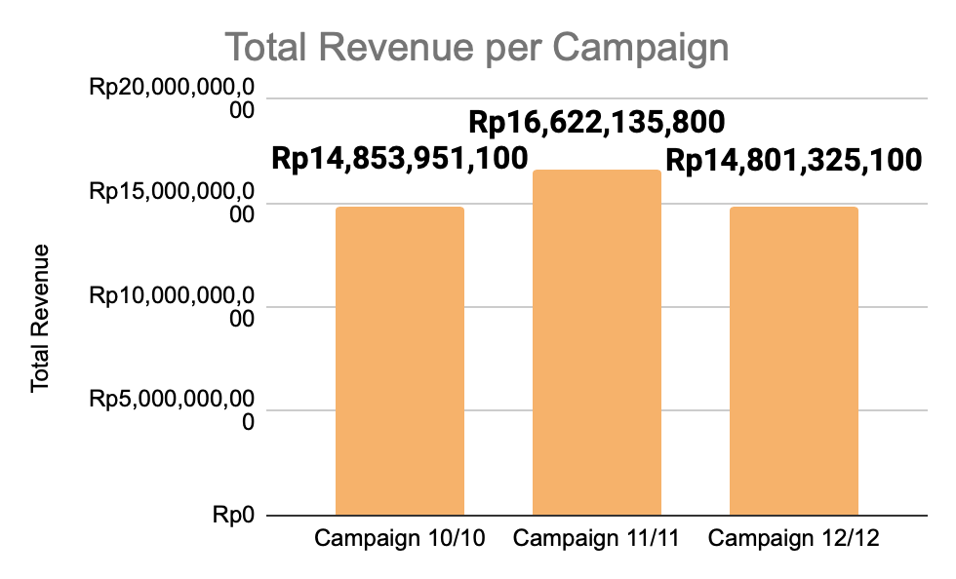
EDA (3/8)
Total Revenue per Campaign
· This chart is created using pivots and summarizes revenue data by sum revenue per each campaign.
· This chart shows the total revenue generated during the three campaign periods. There is a fluctuation in the total revenue across the campaigns.
· The total revenue in the 10/10 campaign (Rp14,853,951,100) increased by 11.9% in the 11/11 campaign (Rp16,622,135,800), then decreased by 11% in the 12/12 campaign (Rp14,801,325,100).
· The total revenue reached its highest amount in the 11/11 campaign and its lowest in the 12/12 campaign.
· The trend in total revenue follows the same fluctuation pattern as the total discount provided. This suggests that a higher discount led to higher revenue, as seen in the 11/11 campaign, where both discount and revenue were at their highest.
· Interestingly, this trend is opposite to the number of transactions trend. Despite the 12/12 campaign having the highest number of transactions, its total revenue was the lowest compared to the other campaigns.
· This indicates that when one customer performs multiple checkouts, it only increases the number of transactions but does not necessarily impact revenue growth. The decrease in revenue during 12/12, despite more transactions, suggests that customers may have made smaller-value purchases in multiple checkouts.
Spreadsheet: https://docs.google.com/spreadsheets/d/1eNbhNIBm-rKsRo5YPQBeqP2iWywkBj8JGB9tNWzQ5FE/edit?usp=sharing

Slide 19
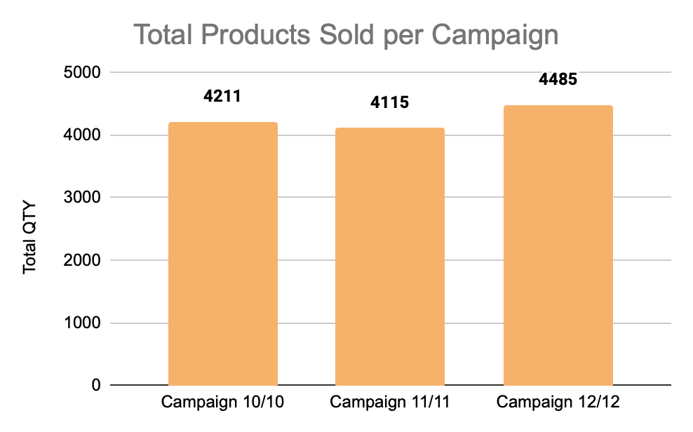
EDA (4/8)
Total Product Sold per Campaign
• This chart displays the total number of products sold during the three promotional campaign periods: 10/10, 11/11, and 12/12.
• The total products sold in the 10/10 campaign reached 4,211 units, then slightly declined in the 11/11 campaign to 4,115 units (a 2.3% decrease from 10/10).
• In the 12/12 campaign, total products sold increased to 4,485 units, rising 9% compared to 11/11 and 6.5% compared to 10/10.
• Overall, the 12/12 campaign recorded the highest number of products sold, while the 11/11 campaign had the lowest sales volume.
• Although the 11/11 campaign generated the highest total revenue, the number of products sold was the lowest. This indicates that the average price of products sold during this period was higher compared to other campaigns.
• Conversely, the 12/12 campaign recorded the highest number of products sold, but based on previous data, its total revenue was actually the lowest. This suggests that even though more products were sold, the value per transaction was lower, possibly due to smaller discounts or customers purchasing lower-priced products.
• This data highlights that an increase in the number of products sold does not always directly correlate with higher revenue. Factors such as average product price, discount strategies, and customer shopping behavior play crucial roles in determining the overall success of a campaign.
Spreadsheet: https://docs.google.com/spreadsheets/d/1eNbhNIBm-rKsRo5YPQBeqP2iWywkBj8JGB9tNWzQ5FE/edit?usp=sharing

Slide 20
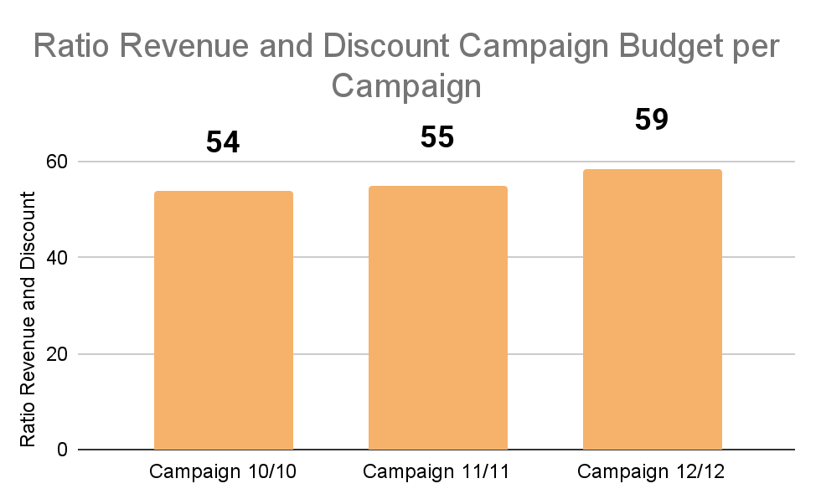
EDA (5/8)
Ratio Revenue and Discount Campaign Budget
• This chart illustrates the revenue-to-discount ratio during the three promotional campaigns: 10/10, 11/11, and 12/12.
• The higher the ratio, the more efficient the discount spending in generating revenue.
• The ratio was 54 in the 10/10 campaign, increased slightly to 55 in the 11/11 campaign, and peaked at 59 in the 12/12 campaign.
• The 12/12 campaign had the highest ratio, meaning that every unit of discount resulted in more revenue compared to the other campaigns.
• Despite the 12/12 campaign having the lowest total revenue, its revenue-to-discount ratio was the highest. This suggests that lower discount incentives may have encouraged customers to purchase products with less dependency on large discounts.
• Conversely, even though the 11/11 campaign generated the highest revenue, its ratio was lower than 12/12, indicating that the revenue increase was heavily influenced by higher discount spending.
• This trend implies that a higher discount does not always guarantee better efficiency in revenue generation. Instead, the optimal balance between discounts and customer spending behavior plays a crucial role in maximizing revenue while maintaining profitability.
 | Campaign 10/10 | Campaign 11/11 | Campaign 12/12
SUM of Total Revenue | Rp14,853,951,100 | Rp16,622,135,800 | Rp14,801,325,100
SUM of Discount | Rp275,925,900 | Rp302,636,200 | Rp252,834,900
Ratio Revenue and Discount Campaign Budget | 54 | 55 | 59
Spreadsheet: https://docs.google.com/spreadsheets/d/1eNbhNIBm-rKsRo5YPQBeqP2iWywkBj8JGB9tNWzQ5FE/edit?usp=sharing

Slide 21
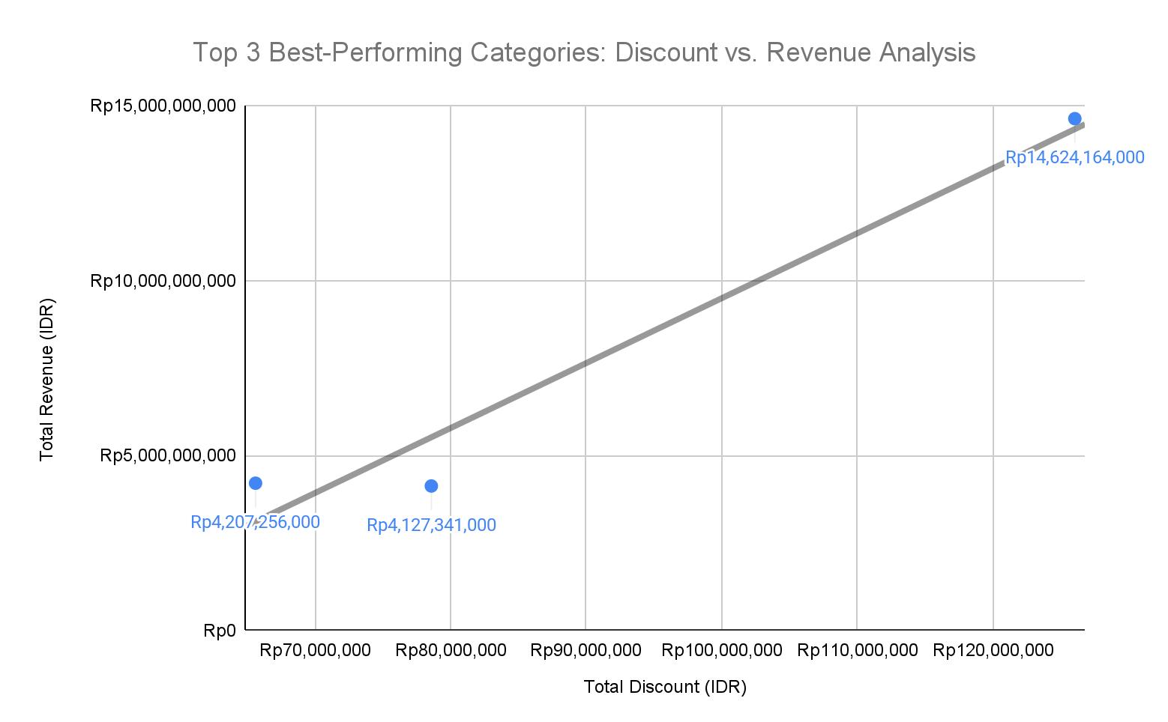
EDA (6/8)
Product category was the best-selling and generated the highest transactions, customers, products sold, and revenue while also having the lowest discount campaign budget, across the three campaign periods
Heatmap Analysis
Top three best-performing categories
Category Name | COUNTA of Transaction ID | COUNTUNIQUE of Customer ID | SUM of QTY | SUM of Total Revenue | SUM of Discount
Men's Fashion | 2504 | 1635 | 2654 | Rp14,624,164,000 | Rp126,036,000
Beauty & Grooming | 1297 | 662 | 1648 | Rp5,829,429,800 | Rp126,041,200
Superstore | 1269 | 394 | 2413 | Rp4,447,251,200 | Rp149,850,800
Health & Sports | 1194 | 344 | 1745 | Rp4,207,256,000 | Rp65,614,000
Women's Fashion | 707 | 434 | 731 | Rp4,127,341,000 | Rp78,579,000
Home & Living | 815 | 529 | 902 | Rp3,471,258,000 | Rp67,619,000
Mobiles & Tablets | 686 | 508 | 745 | Rp2,641,682,000 | Rp44,848,000
Soghaat | 636 | 265 | 821 | Rp2,108,225,000 | Rp44,109,000
Appliances | 295 | 254 | 344 | Rp1,976,429,000 | Rp61,761,000
Kids & Baby | 412 | 248 | 454 | Rp1,369,652,000 | Rp38,198,000
Computing | 155 | 130 | 171 | Rp782,882,000 | Rp17,108,000
School & Education | 99 | 65 | 107 | Rp301,666,000 | Rp5,079,000
Entertainment | 49 | 46 | 51 | Rp271,699,000 | Rp5,511,000
Books | 22 | 17 | 22 | Rp105,977,000 | Rp1,043,000
Others | 2 | 2 | 3 | Rp12,500,000 | Rp0
Rank | Category Name | Total Revenue | Discount
1 | Men's Fashion | Rp14,624,164,000 | Rp126,036,000
2 | Health & Sports | Rp4,207,256,000 | Rp65,614,000
3 | Women's Fashion | Rp4,127,341,000 | Rp78,579,000
The top 3 best-performing categories are determined based on products that generate high revenue while maintaining relatively low discounts.
The scatter plot visualizes the relationship between total discounts and total revenue for the top 3 best-performing categories: Men’s Fashion, Health & Sports, and Women’s Fashion.
Men’s Fashion is the dominant category in all aspects (transactions, customers, products sold, and revenue), even though its discount is relatively high (Rp14,624,164,000). It generates the highest revenue (Rp126,036,000), demonstrating strong sales performance.
Health & Sports shows high efficiency by generating significant revenue (Rp4,207,256,000) with a lower discount (Rp65,614,000) compared to other major categories. This suggests that the category effectively maximizes revenue with minimal discounting.
Women’s Fashion balances revenue (Rp4,127,341,000) and discount efficiency (Rp78,579,000), making it superior to categories like Beauty & Grooming or Superstore.
The trendline suggests a positive correlation between discounts and revenue. However, Health & Sports stands out for its efficiency, while Men’s Fashion dominates in absolute revenue, and Women’s Fashion excels in strategic discounting.
The heatmap aggregates data from three campaign periods, summarizing key metrics such as transactions, customers, products sold, revenue, and discounts for each category.
Spreadsheet: https://docs.google.com/spreadsheets/d/1eNbhNIBm-rKsRo5YPQBeqP2iWywkBj8JGB9tNWzQ5FE/edit?usp=sharing

Slide 22
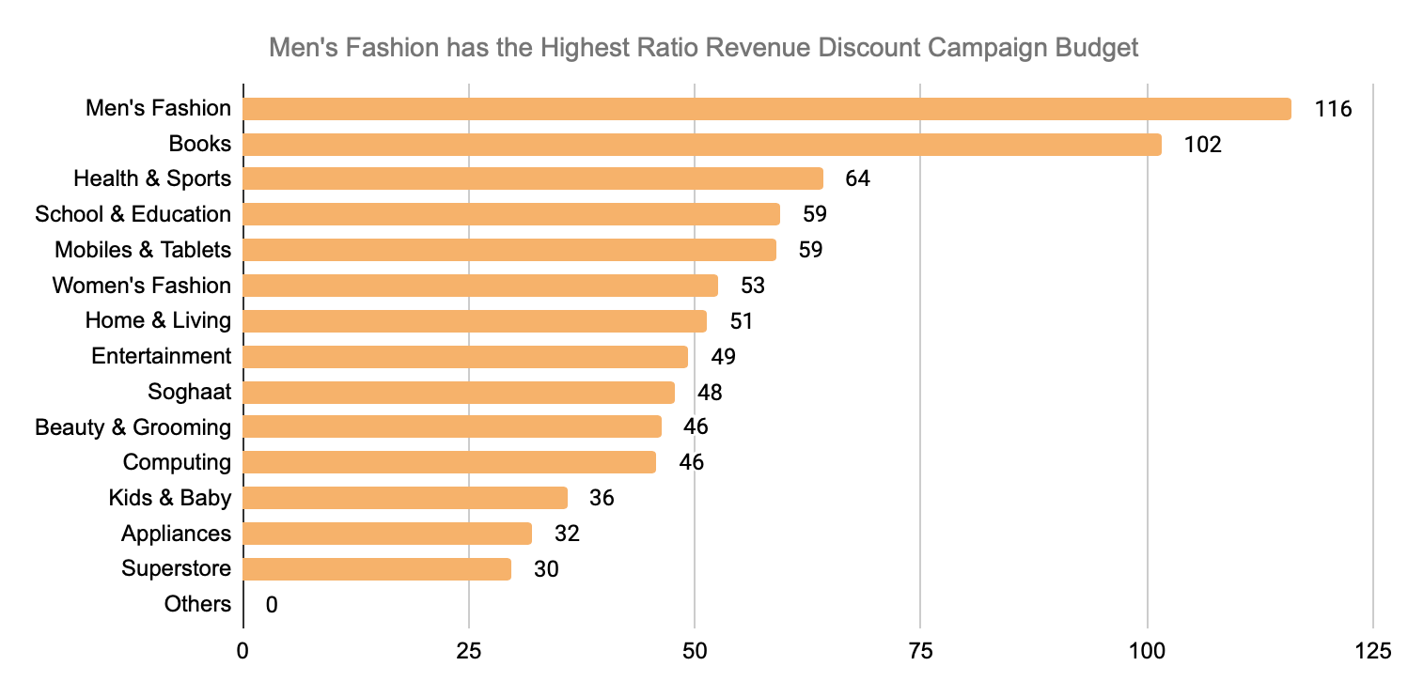
EDA (7/8)
Product category received the highest ratio revenue and discount campaign budget from the three campaign periods
Heatmap Analysis
Category Name | SUM of Total Revenue | SUM of Discount | Ratio Revenue Discount
Men's Fashion | Rp14,624,164,000 | Rp126,036,000 | 116
Books | Rp105,977,000 | Rp1,043,000 | 102
Health & Sports | Rp4,207,256,000 | Rp65,614,000 | 64
School & Education | Rp301,666,000 | Rp5,079,000 | 59
Mobiles & Tablets | Rp2,641,682,000 | Rp44,848,000 | 59
Women's Fashion | Rp4,127,341,000 | Rp78,579,000 | 53
Home & Living | Rp3,471,258,000 | Rp67,619,000 | 51
Entertainment | Rp271,699,000 | Rp5,511,000 | 49
Soghaat | Rp2,108,225,000 | Rp44,109,000 | 48
Beauty & Grooming | Rp5,829,429,800 | Rp126,041,200 | 46
Computing | Rp782,882,000 | Rp17,108,000 | 46
Kids & Baby | Rp1,369,652,000 | Rp38,198,000 | 36
Appliances | Rp1,976,429,000 | Rp61,761,000 | 32
Superstore | Rp4,447,251,200 | Rp149,850,800 | 30
Others | Rp12,500,000 | Rp0 | 0
The heatmap aggregates data from three campaign periods, summarizing key metrics such as revenue, and discounts and ratio revenue discount for each category.
The bar chart illustrates the Ratio of Revenue to Discount Campaign Budget across different product categories. This ratio represents how efficiently each category converts its discount budget into revenue.
Men’s Fashion (116) is the most profitable category with the highest ratio, indicating the effectiveness of its discount strategy in generating significant revenue.
Books (102) also has a very high ratio, despite its total revenue being smaller compared to other categories. This indicates that the discount campaign in this category is highly efficient in driving revenue growth.
Health & Sports (64), Mobiles & Tablets (59), School & Education (59), Women’s Fashion (53), and Home & Living (51) have relatively good ratios. These categories demonstrate a well-balanced relationship between the discounts offered and the revenue generated. Making them stable categories in business performance.
Superstore (30), Appliances (32), and Kids & Baby (36) have the lowest ratios, meaning they generate lower revenue relative to their discount spending and may need to reassess their discount strategies to ensure the effectiveness of their promotional campaigns.
The "Others" category had no discounts but still generated Rp12,500,000 in revenue. This indicates that products in this category can still sell even without a discount campaign.
Spreadsheet: https://docs.google.com/spreadsheets/d/1eNbhNIBm-rKsRo5YPQBeqP2iWywkBj8JGB9tNWzQ5FE/edit?usp=sharing

Slide 23
EDA (8/8)
Insight and Business Recommendation
Strategic Insight | Business Recommendation
Lower discounts can still drive strong revenue efficiency, as seen in the improving revenue-to-discount ratio (from 54 in 10/10 to 59 in 12/12). | Optimizing Discounts for Profitability | Use Smart Discounting: Implement data-driven A/B testing to find optimal discount levels that maximize sales without eroding profits.
Higher discounts don’t always lead to higher profitability. 12/12 had the highest efficiency despite lower discounts. |  | Focus on Value-Driven Promotions: Shift from deep discounts to loyalty programs, exclusive deals, and targeted offers.
Men’s & Women’s Fashion dominate in revenue and discount efficiency, showing strong demand. | Leveraging Top-Performing Categories | Launch "Fashion Day" Sales Event: Maximize sales through strategic, time-limited discounts while maintaining profitability.
Books have high discount efficiency (ratio of 102), proving that strategic discounts work well in this category. | Boosting Sales Through Smart Bundling & Pricing | Introduce Subscription & Bulk Discounts: Reduce discount dependency by offering multi-purchase deals and subscription models.
Non-discounted products still generate revenue, proving that some items don’t need discounts to sell. |  | Leverage Premium Pricing & Pre-Orders: Introduce exclusive product lines and pre-order campaigns to maintain high-value perception.
Superstore, Appliances, and Kids & Baby struggle with low discount efficiency, meaning high discounts don’t translate to strong sales. | Fixing Underperforming Categories | Bundle Best-Sellers with Slow Movers: Create cross-category bundles (e.g., Beauty & Grooming + Kids & Baby: Mom & Baby Care Set) to drive sales in weaker categories.
Heavy discounting in low-performing categories isn’t effective. |  | Shift to Value-Added Offers: Improve perceived value with premium packaging, extended warranties, and limited-time exclusives instead of price cuts.
Spreadsheet: https://docs.google.com/spreadsheets/d/1eNbhNIBm-rKsRo5YPQBeqP2iWywkBj8JGB9tNWzQ5FE/edit?usp=sharing

Slide 24
Hypothesis Testing (1/4)
Is there any significant difference between Campaign 10/10 and Campaign 11/11 Total Revenue?
Hypothesis
Alpha
Statistical Test
Kriteria Keputusan
Kesimpulan
Insight bisnis
Hypothesis
Null Hypothesis (H₀): There is no significant difference in total revenue between Campaign 10/10 and Campaign 11/11.
Alternative Hypothesis (H₁): There is a significant difference in total revenue between Campaign 10/10 and Campaign 11/11.
Alpha (Significance Level)
α = 0.05 (5%)
Statistical Test (T-test)
Variance Sample 10/10 Campaign = 6994044361764
Variance Sample 11/11 Campaign = 6957590470647
Differences between 2 Variance = 1% < 10% -> This small variance difference justifies the use of a t-test assuming equal variances.
Decision Criteria
If p-value < α, reject H₀
If p-value > α, accept H₀
Conclusion
P-value (two-tailed) = 0.000 < 0.05, we reject H₀
This means there is a statistically significant difference in total revenue between Campaign 10/10 and Campaign 11/11.
Business Insight
In terms of mean revenue, since Campaign 11/11 (4,890,302) > Campaign 10/10 (4,461,986), it can be identified that Campaign 11/11 was more effective than Campaign 10/10 in increasing revenue.
t-Test: Two-Sample Assuming Equal Variances
 | Total Revenue of Campaign 10/10 | Total Revenue of Campaign 11/11
Mean | 4,461,986 | 4,890,302
Variance | 6,994,044,361,764 | 6,957,590,470,647
Observations | 3,329 | 3,399
Pooled Variance | 6,975,627,721,559
Hypothesized Mean Difference | 0
df | 6,726
t Stat | -6.65061825949
P(T<=t) one-tail | 0.00000000002
t Critical one-tail | 1.64508014728
P(T<=t) two-tail | 0.00000000003
t Critical two-tail | 1.96031669411
Spreadsheet: https://docs.google.com/spreadsheets/d/1eNbhNIBm-rKsRo5YPQBeqP2iWywkBj8JGB9tNWzQ5FE/edit?usp=sharing

Slide 25
Hypothesis Testing (2/4)
Is there any significant difference between Campaign 10/10 and Campaign 12/12 Total Revenue?
Hypothesis
Alpha
Statistical Test
Kriteria Keputusan
Kesimpulan
Insight bisnis
Hypothesis
Null Hypothesis (H₀): There is no significant difference in total revenue between Campaign 10/10 and Campaign 12/12.
Alternative Hypothesis (H₁): There is a significant difference in total revenue between Campaign 10/10 and Campaign 12/12.
Alpha (Significance Level)
α = 0.05 (5%)
Statistical Test (T-test)
Variance Sample 10/10 Campaign = 6994044361764
Variance Sample 12/12 Campaign = 7300189181921
Differences between 2 Variances = 4% < 10% -> This small variance difference justifies the use of a t-test assuming equal variances.
Decision Criteria
If p-value < α, reject H₀
If p-value > α, accept H₀
Conclusion
P-value (two-tailed) = 0.0521> 0.05, we accept H₀ at a 5% significance level.
The difference is not strong enough to conclude a significant change in total revenue between Campaign 10/10 and Campaign 12/12.
Business Insight
Campaign 12/12 did not bring significant different of revenue to TokoBli Ecommerce, indicating that the promotional strategy used in 12/12 was not effective
t-Test: Two-Sample Assuming Equal Variances
 | Total Revenue of Campaign 10/10 | Total Revenue of Campaign 12/12
Mean | 4,461,986 | 4,335,479
Variance | 6,994,044,361,764 | 7,300,189,181,921
Observations | 3,329 | 3,414
Pooled Variance | 7,149,046,923,876
Hypothesized Mean Difference | 0
df | 6,741
t Stat | 1.942461694
P(T<=t) one-tail | 0.026061414
t Critical one-tail | 1.645079643
P(T<=t) two-tail | 0.052122829
t Critical two-tail | 1.960315909
Spreadsheet: https://docs.google.com/spreadsheets/d/1eNbhNIBm-rKsRo5YPQBeqP2iWywkBj8JGB9tNWzQ5FE/edit?usp=sharing

Slide 26
Hypothesis Testing (3/4)
Is there any significant difference between Campaign 11/11 and Campaign 12/12 Total Revenue?
Hypothesis
Alpha
Statistical Test
Kriteria Keputusan
Kesimpulan
Insight bisnis
Hypothesis
Null Hypothesis (H₀): There is no significant difference in total revenue between Campaign 11/11 and Campaign 12/12.
Alternative Hypothesis (H₁): There is a significant difference in total revenue between Campaign 11/11 and Campaign 12/12.
Alpha (Significance Level)
α = 0.05 (5%)
Statistical Test (T-test)
Variance Sample 11/11 Campaign = 6957590470647
Variance Sample 12/12 Campaign = 7300189181921
Differences between 2 Variances = 5% < 10% -> This small variance difference justifies the use of a t-test assuming equal variances.
Decision Criteria
If p-value < α, reject H₀
If p-value > α, accept H₀
Conclusion
P-value (two-tailed) = 0.000 < 0.05, we reject H₀
This means there is a statistically significant difference in total revenue between Campaign 11/11 and Campaign 12/12.
Business Insight
In terms of mean revenue, since Campaign 12/12 (4,335,479) < Campaign 11/11 (4,890,302), it can be identified that Campaign 12/12 was less effective than Campaign 11/11 in increasing revenue.
t-Test: Two-Sample Assuming Equal Variances
 | Total Revenue of Campaign 11/11 | Total Revenue of Campaign 12/12
Mean | 4,890,302 | 4,335,479
Variance | 6,957,590,470,647 | 7,300,189,181,921
Observations | 3,399 | 3,414
Pooled Variance | 7,129,267,082,243
Hypothesized Mean Difference | 0
df | 6,811
t Stat | 8.5757092151
P(T<=t) one-tail | 0.0000000000
t Critical one-tail | 1.6450773192
P(T<=t) two-tail | 0.0000000000
t Critical two-tail | 1.9603122909
Spreadsheet: https://docs.google.com/spreadsheets/d/1eNbhNIBm-rKsRo5YPQBeqP2iWywkBj8JGB9tNWzQ5FE/edit?usp=sharing

Slide 27
Hypothesis Testing (4/4)
Insight and Business Recommendation
Business Insight | Business Recommendation
Campaign 11/11 was the most effective compared to both 10/10 and 12/12 , showing the highest revenue. | Since 11/11 was the most successful campaign, analyze its key success variables (e.g., discount depth, product selection, marketing channels, timing) and replicate them in future campaigns. Maintain or enhance promotional strategies that drove higher engagement and conversion rates. Conduct customer sentiment analysis to understand why 12/12 underperformed—was it pricing, lack of urgency, or ineffective promotions Customer fatigue post-11/11 might have affected 12/12 sales—explore adjusting timing or structuring discounts differently (e.g., flash sales, bundle deals, tiered discounts). Test alternative promotional periods outside of major campaign to sustain revenue momentum. Use data-driven segmentation to offer personalized deals based on past purchases and customer behavior.
Campaign 12/12 underperformed compared to both 10/10 and 11/11
Spreadsheet: https://docs.google.com/spreadsheets/d/1eNbhNIBm-rKsRo5YPQBeqP2iWywkBj8JGB9tNWzQ5FE/edit?usp=sharing

Slide 28

THANK YOU

